Slide 1
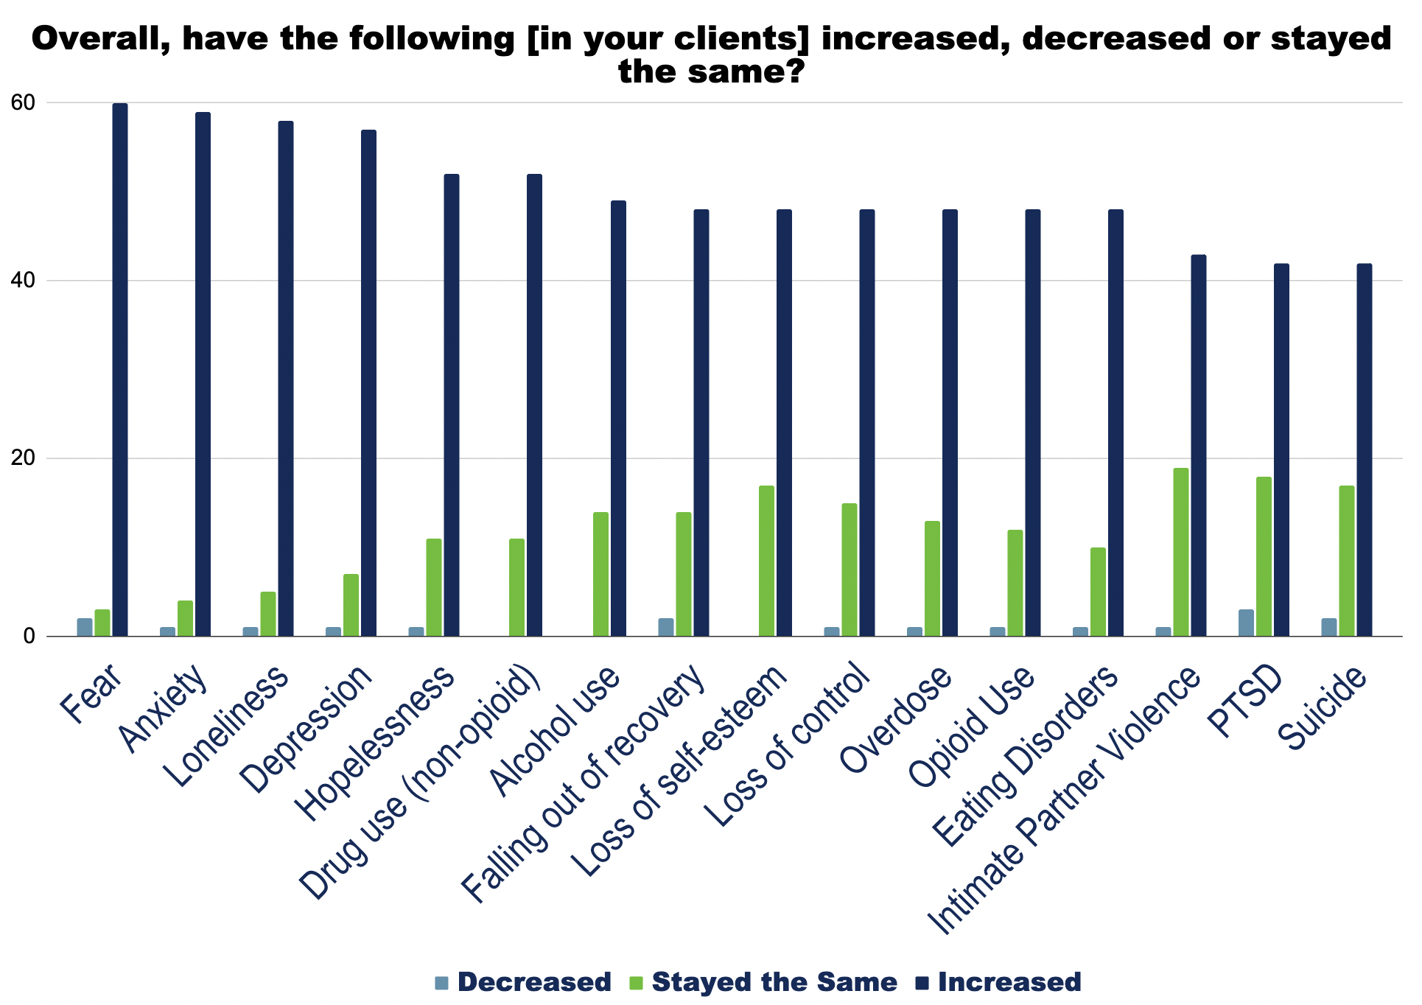
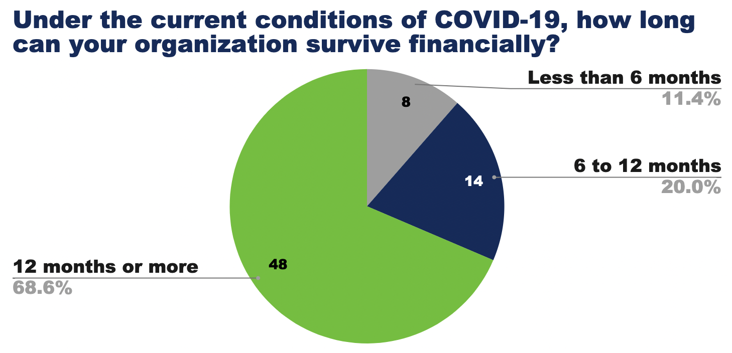
Athens Wellbeing Project
Harrison Huang | Grace Bagwell Adams | Epidemiology | Spring 2021
Site Description
Images
Results
The Athens Wellbeing Project (AWP) aims to empower the Athens community with meaningful data that will lead to more informed decision-making and greater quality of life for our citizens. AWP collects representative sample data from Athens-Clarke county, publishing reports that focus on its its 5 domain areas: lifelong learning, health, housing, community safety, and civic vitality. In addition, they fill other public health gaps in the community through other projects like this behavioral health community needs assessment or partnerships with other community stakeholders like the Athens Area Community Foundation and Envision Athens.
Telehealth
Prior to COVID-19, only 30% of providers used telehealth. Now, 77.5% do.
75.9% plan to continue use after the pandemic.
Medication Assisted Treatment (MAT)/Naloxone
18% of respondents offer either MAT or naloxone; 17% offer both MAT and naloxone
There was not a net change in the number of MAT/naloxone providers due to COVID-19
21% of organizations that do not offer MAT responded that they willing to engage in MAT.
Project Description
Products
We conducted a behavioral health community needs assessment surveying behavioral health providers in Athens and its contiguous counties with a focus on the effects of COVID-19. The survey was sent in November of 2020 with 65 organizations responding. The survey was comprised of 65 quantitative and qualitative questions focusing on finances and sustainability, supply availability, opioid treatment, telemedicine, COVID-19 procedures, and client information.
This poster focused on the behavioral health community needs assessment for which a presentation was made, and the written report is being produced, but additional products from this internship included:
8 social media infographics/one-pagers using data from past AWP reports
Flyers regarding SNAP eligibility and CDC’s eviction moratorium

