Slide 1
Conserving the Sonoran Pronghorn

Slide 2
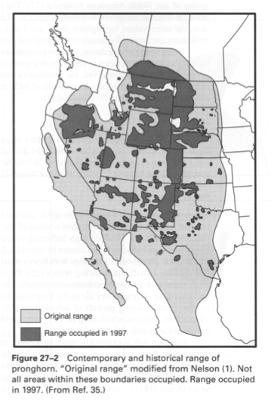
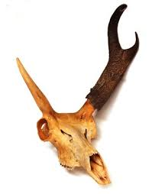
Pronghorn (Antilocapra americana)
-Fastest mammal in North America
-Has both antlers (shed) and horns (permanent)
-5 recognized subspecies
-Sonoran subspecies (A. antilocapra sonoriensis) has both Endangered and Non-essential Experimental populations exist
-Habitat is mostly grasslands or shrubby grasslands
-Diet mainly consists of protein succulents and forbs
-Threats are predominately Anthropogenic
-

Slide 3
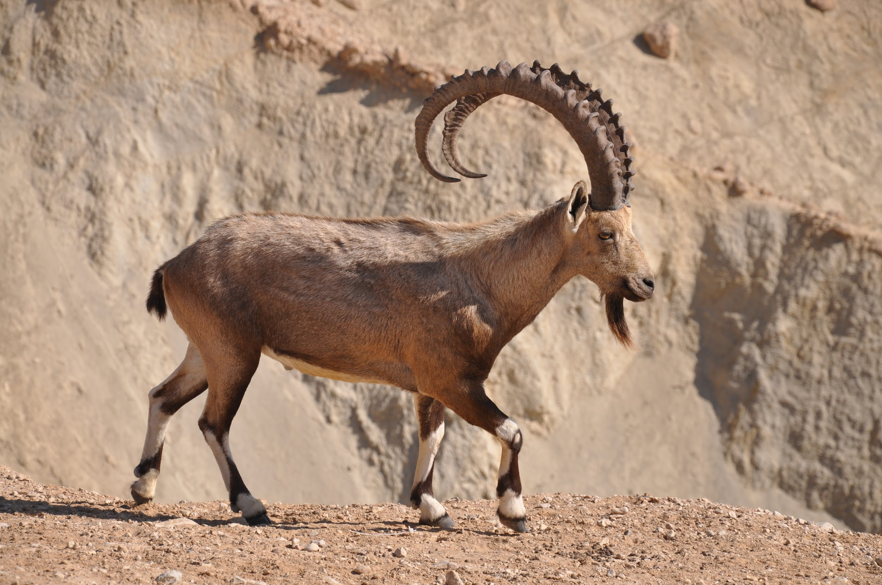
Action
Objectives
Maintenance of populations
Minimal human disturbance
Identify and attend to pronghorn needs

Slide 4
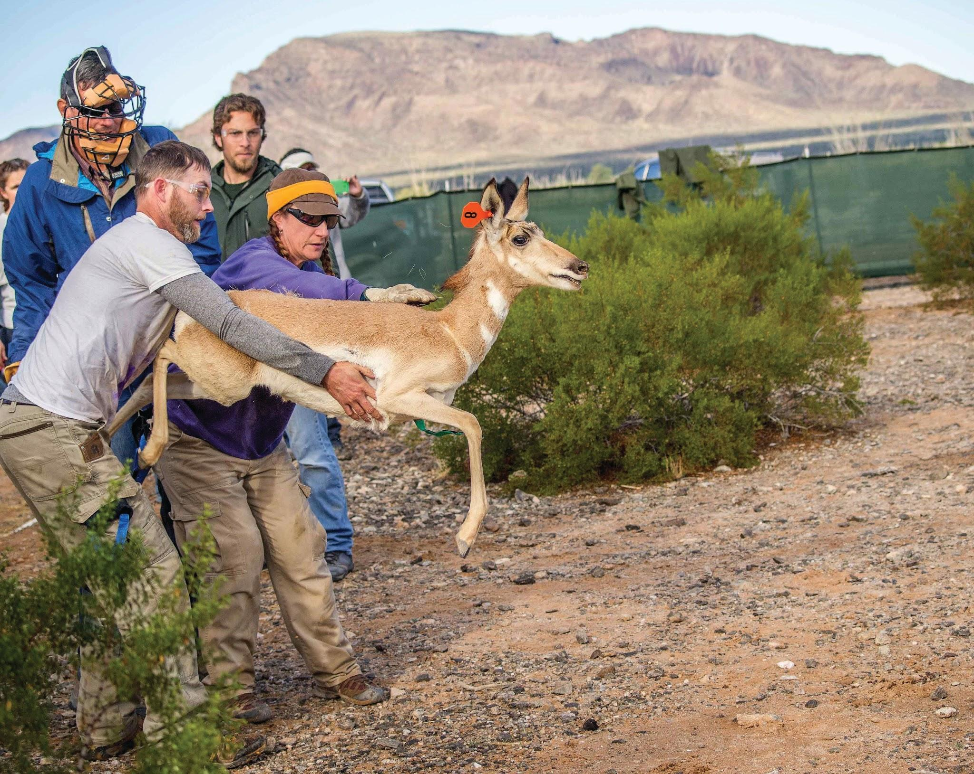
Action cont.
Cabeza Prieta National Wildlife Refuge
Captive breeding program
Population growth
Limited predator interactions
Efforts
Cisterns
Water-catchments
Foraging plots
Sonoran Pronghorn released into the wild
from Cabeza Prieta National Wildlife Refuge
Notes:
-US Fish and Wildlife service did captive breeding in 2003
-some males released after three years
-population now at 205 as of 2016

Slide 5
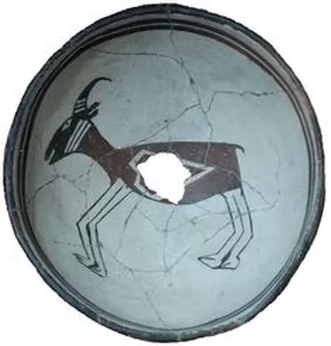
Value
ECOLOGICAL
important consumer and ruminant species
maintains ecological balance
creates natural disturbance with “scrapes”
contributes to ecosystem complexity and vegetative & faunal diversity
CULTURAL
Native Americans
subsistence
communal hunting activity
skins for clothing
spiritual value
abundance as a sign of nature’s blessing
artifacts: pottery, tools, bones in burials, wall paintings
preserving pronghorn preserves original american culture since they are an original native species
ECONOMIC
beneficial to ranchmen due to diet on vegetation
feed on and maintain the presence of unwanted weeds, desirable grasses grow instead
facilitate growth of vegetation in areas that are overgrazed by livestock.
free service that would otherwise cost $ for labor/maintenance

Slide 6
Threats to the Sonoran Pronghorn
Status
Human Threats
-Historical
- Modern
Crises

